Slide 1
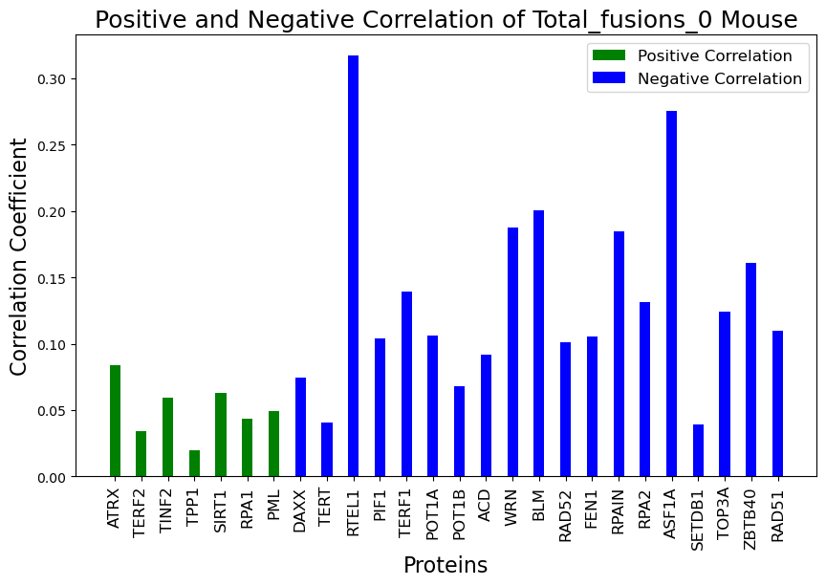
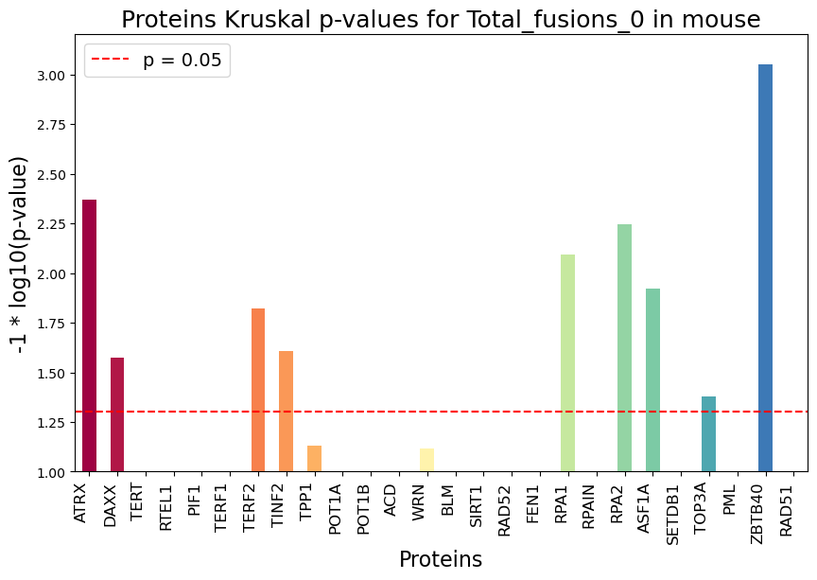
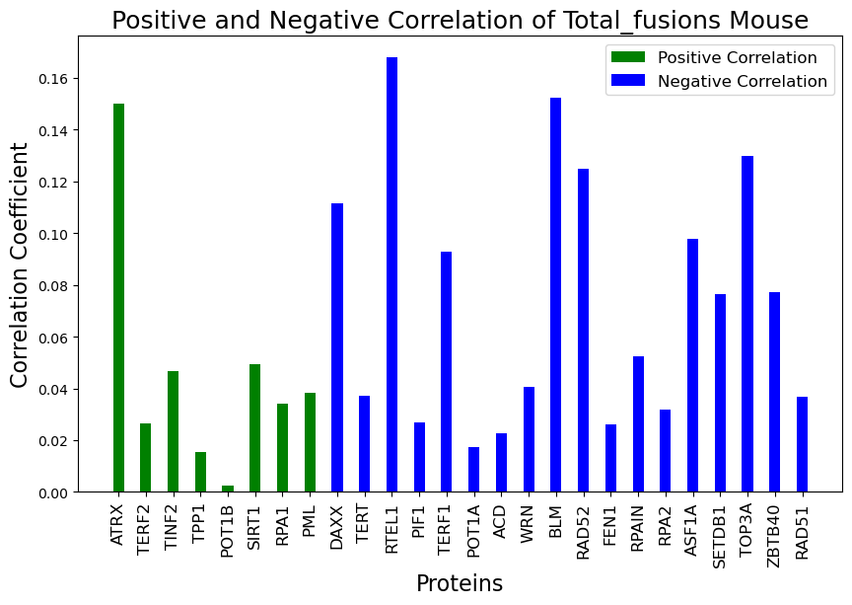
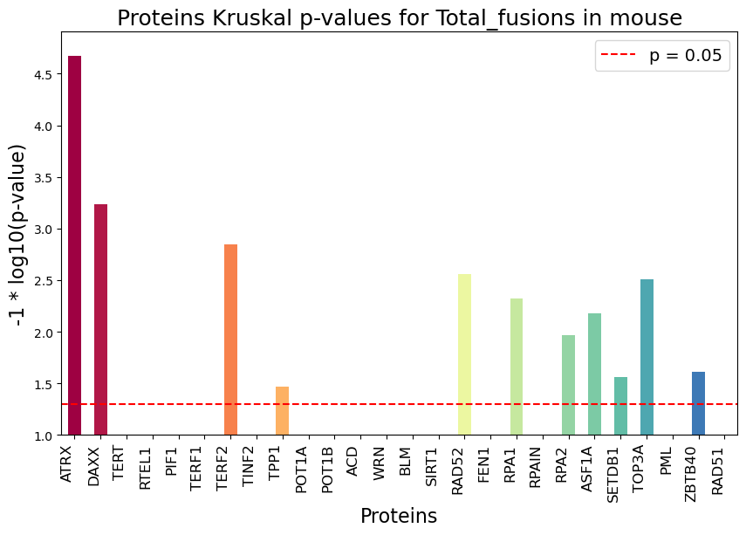
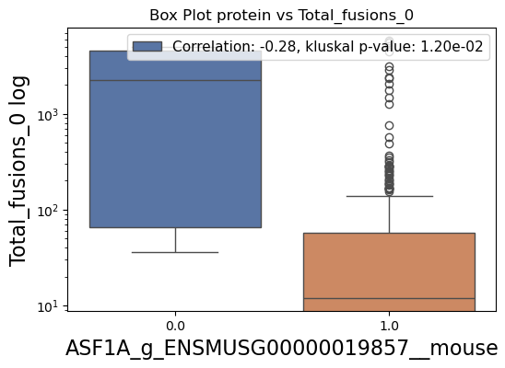
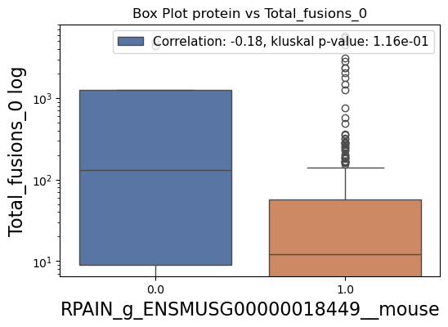
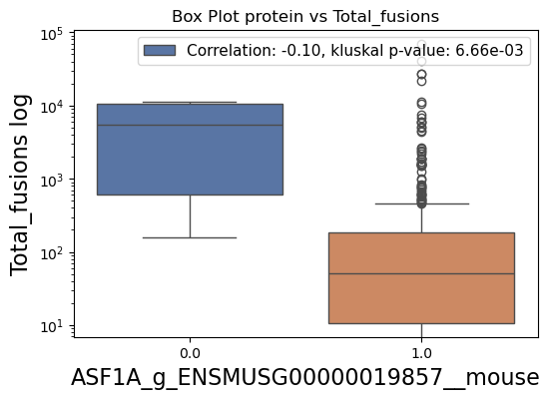
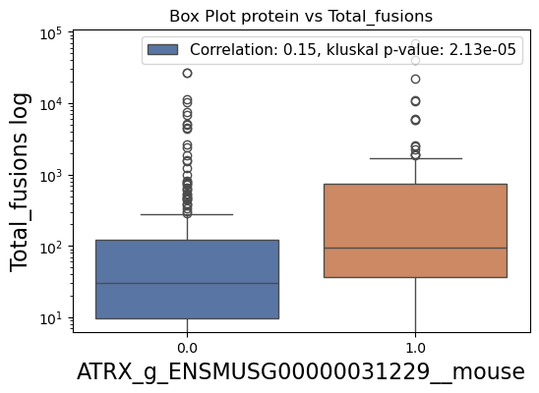
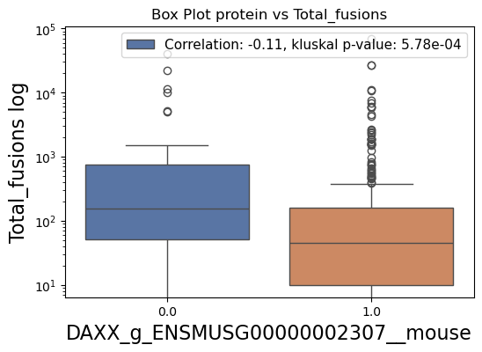
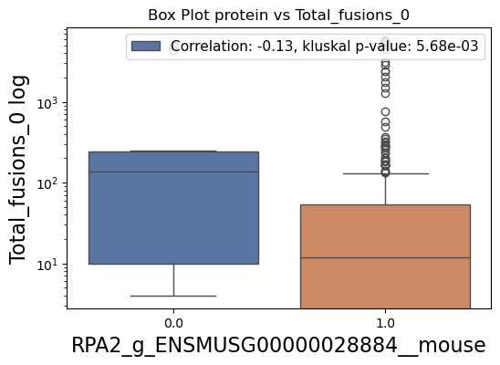
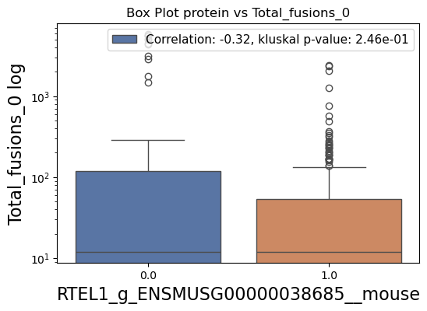
a)
c)
b)
d)
e)

Slide 2
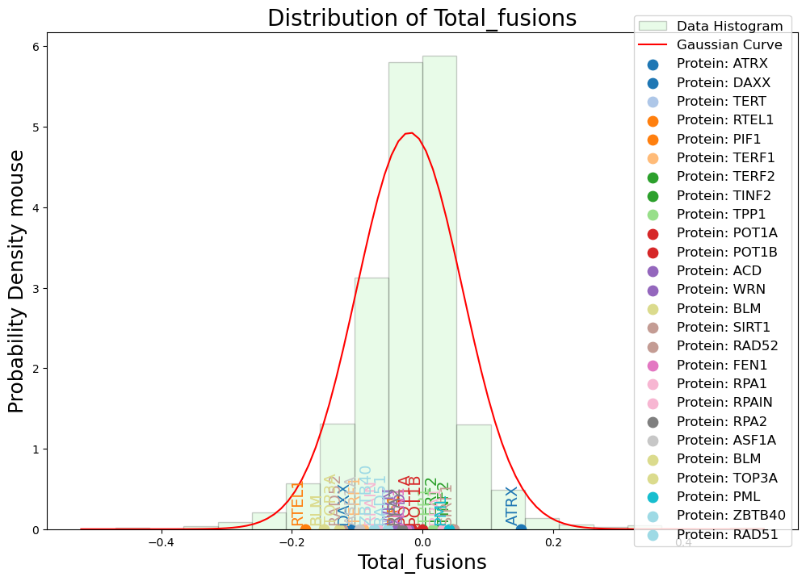
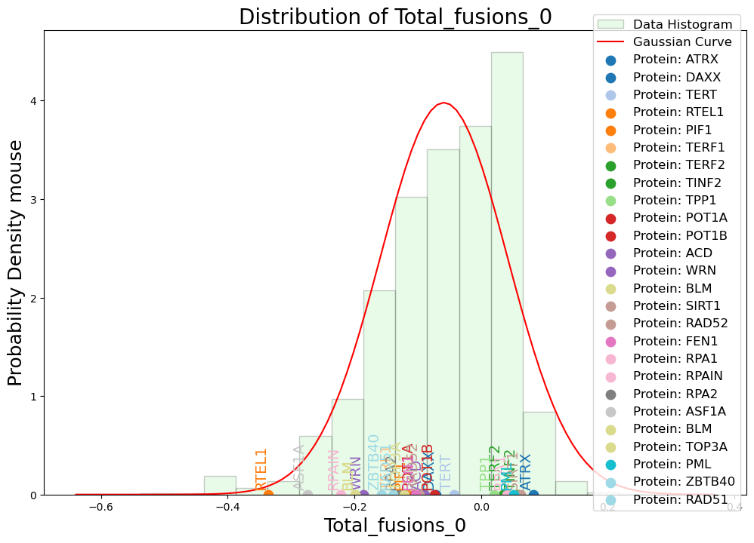

Slide 3
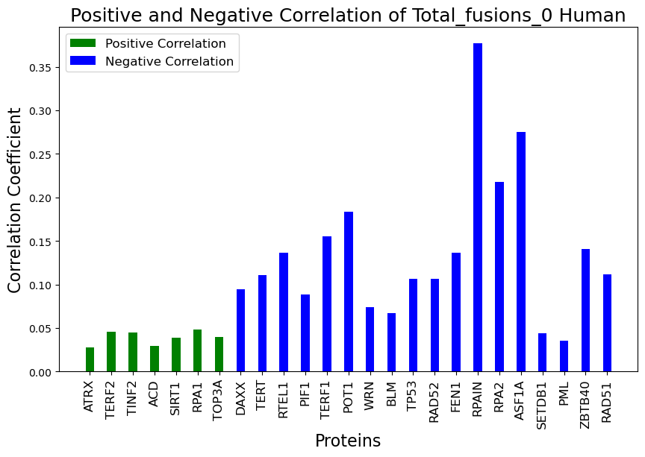
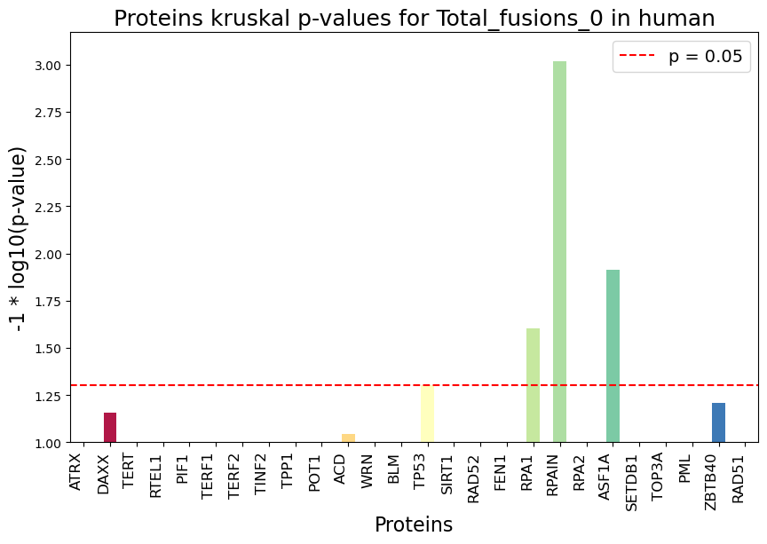
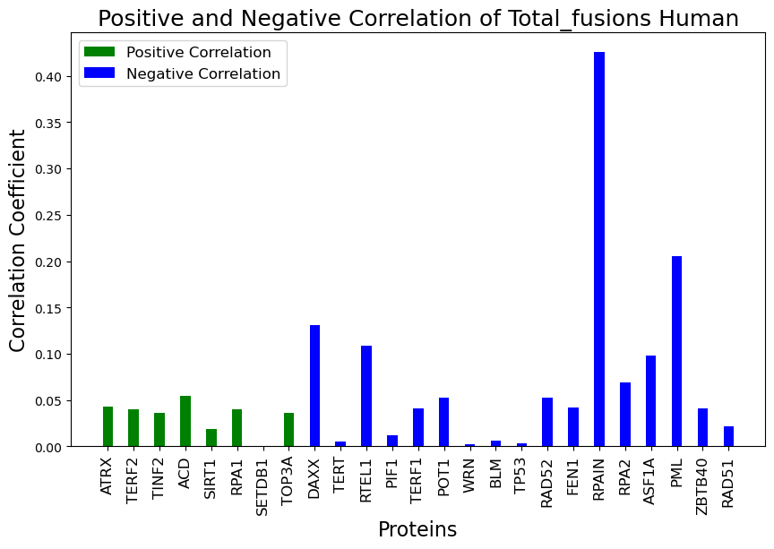
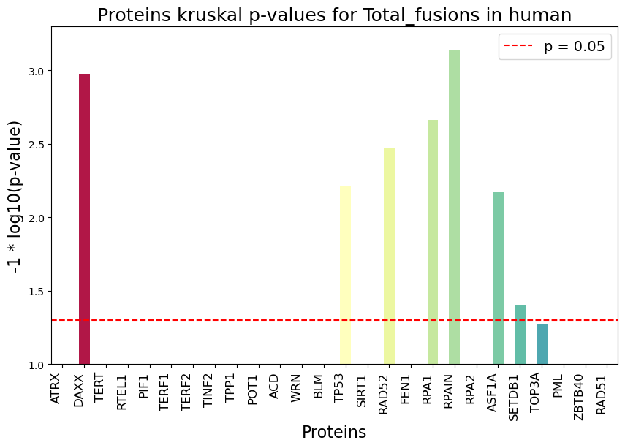
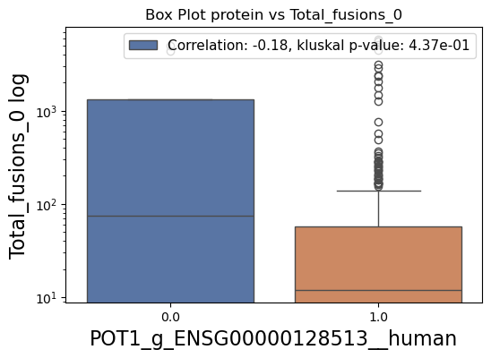
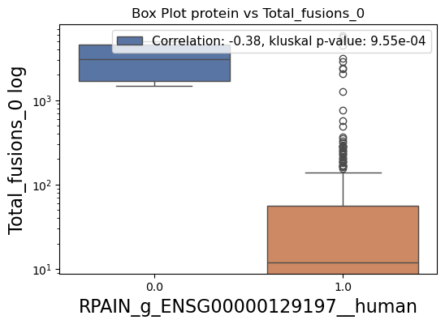
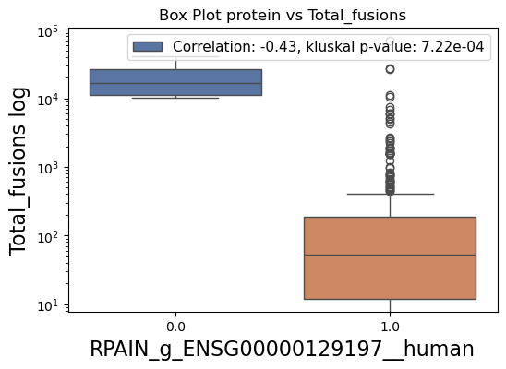
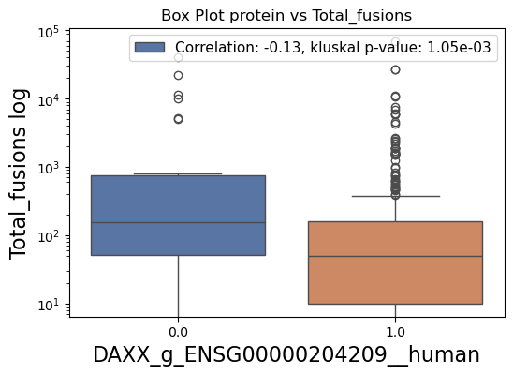
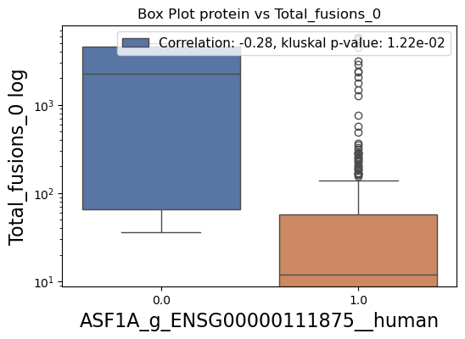
a)
c)
b)
d)

Slide 4
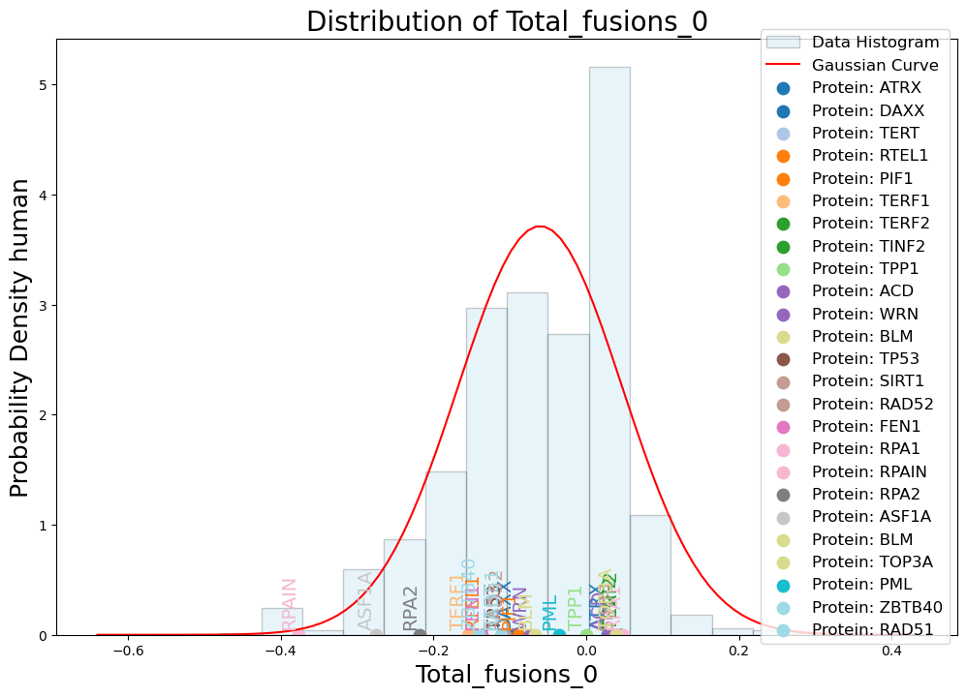
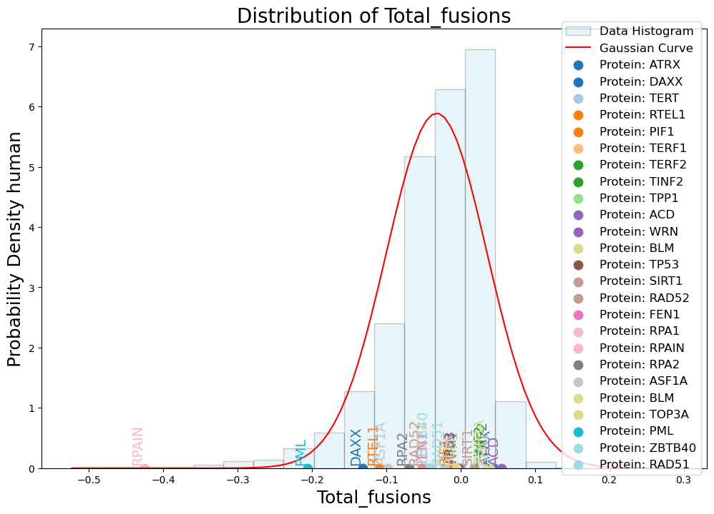

Slide 5
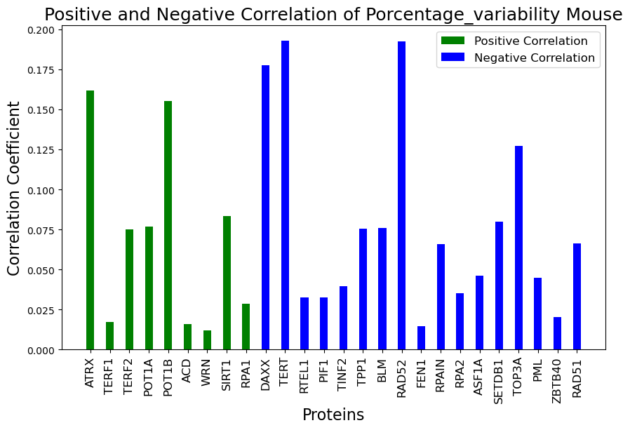
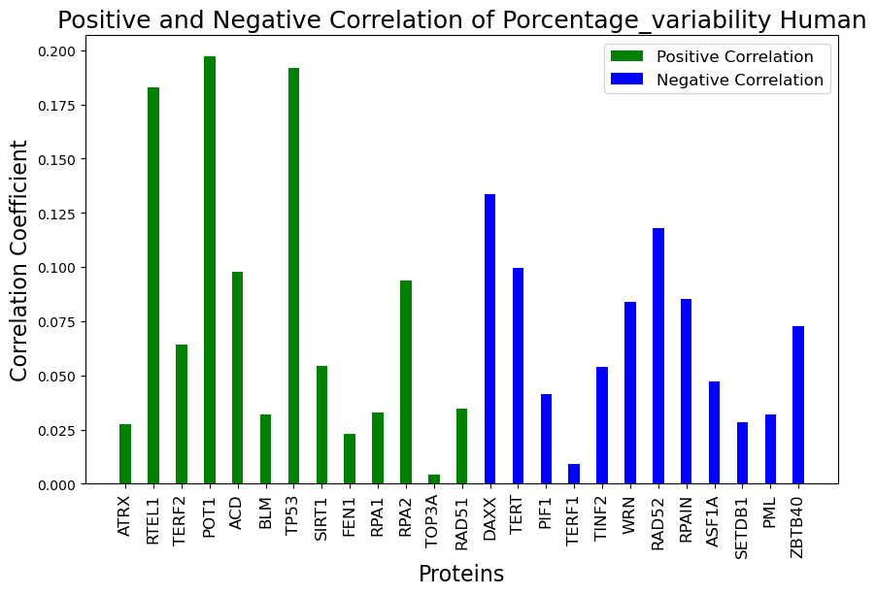
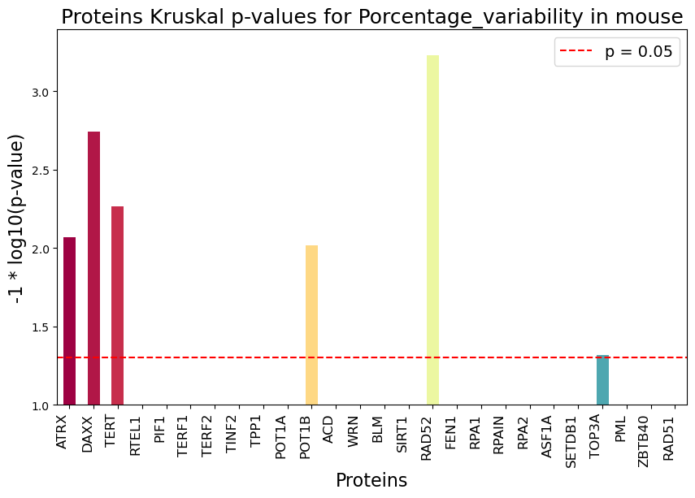
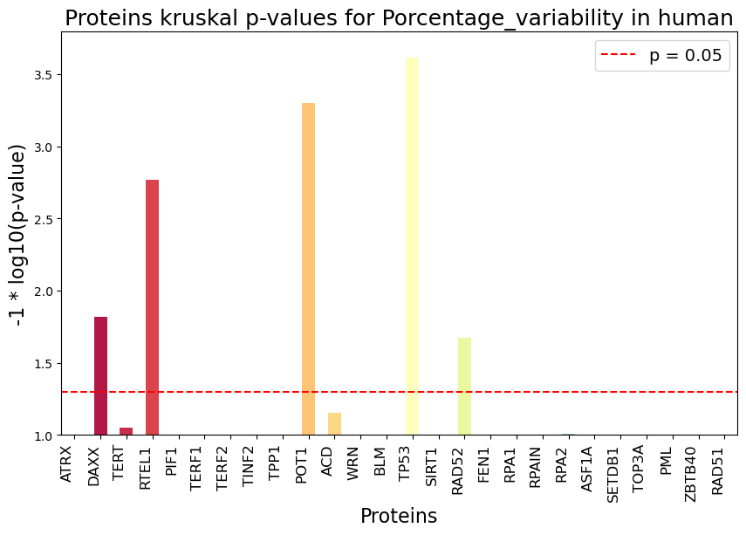
a)
b)

Slide 6
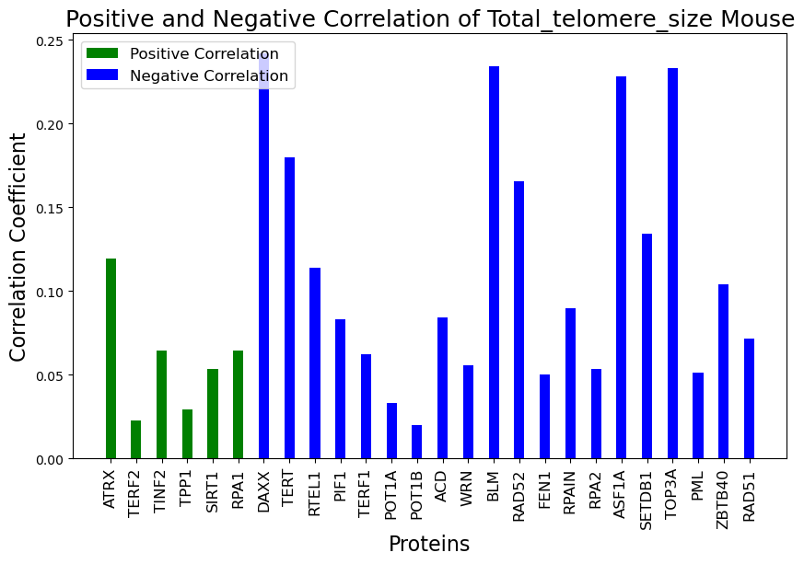
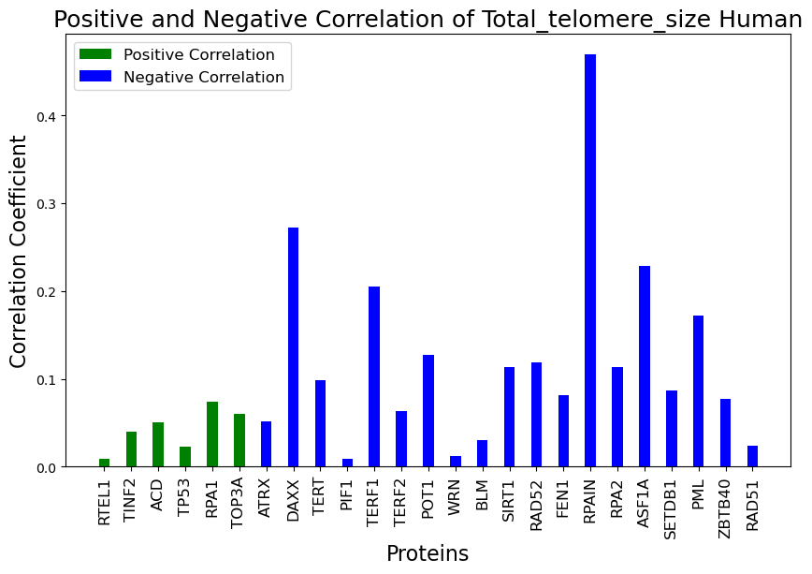
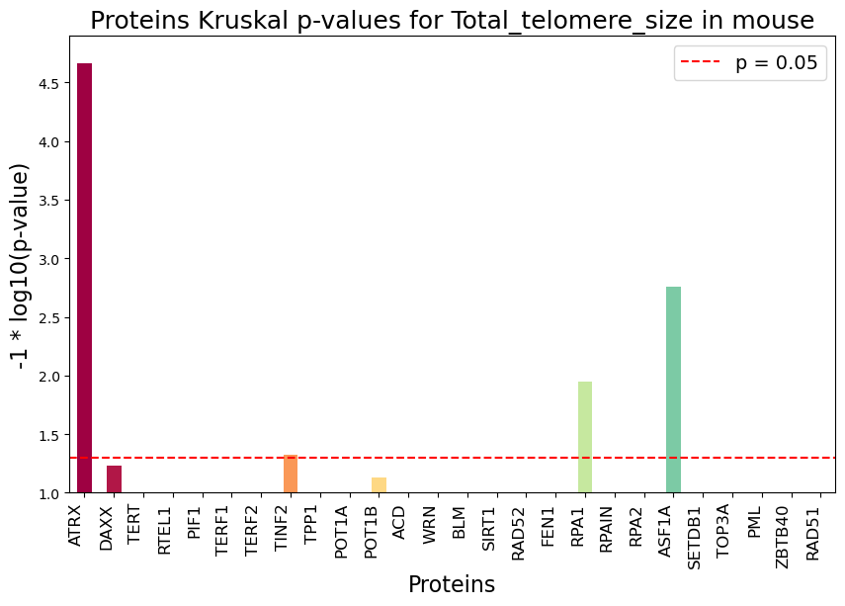
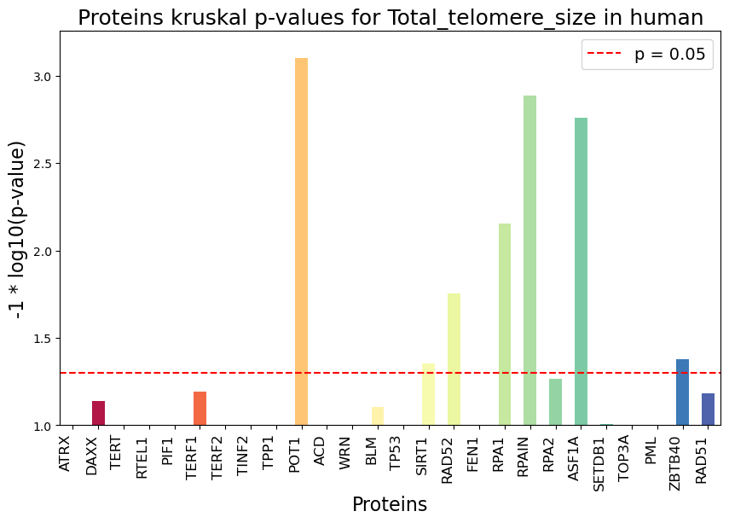
a)
b)

Slide 7
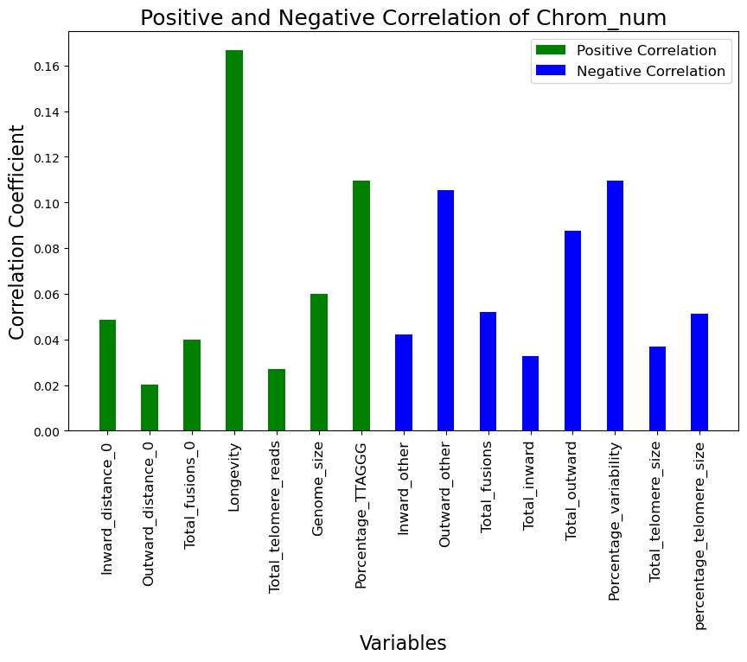
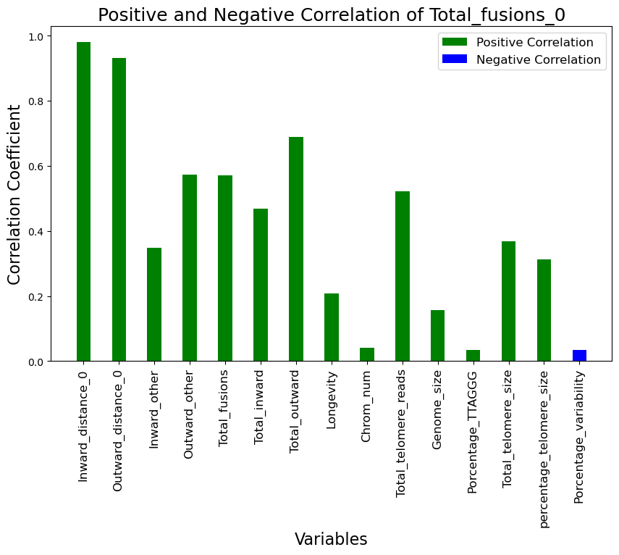
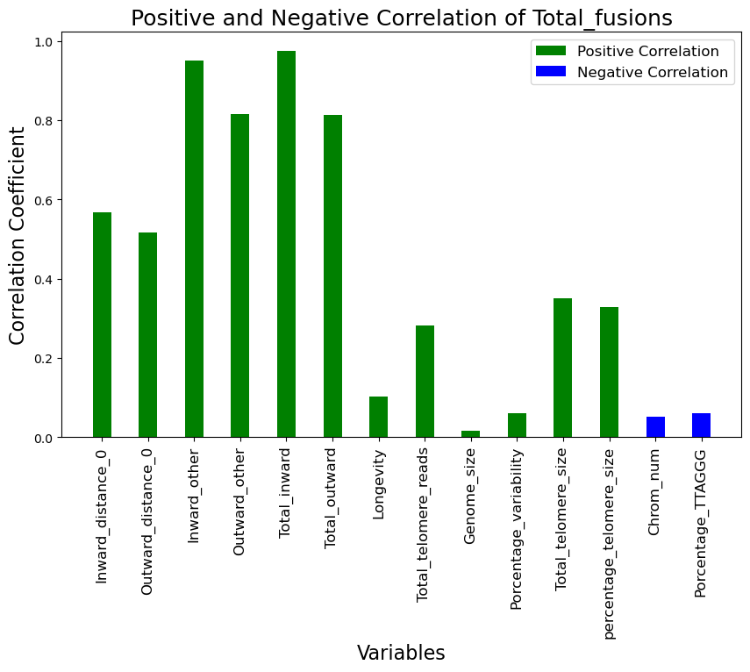
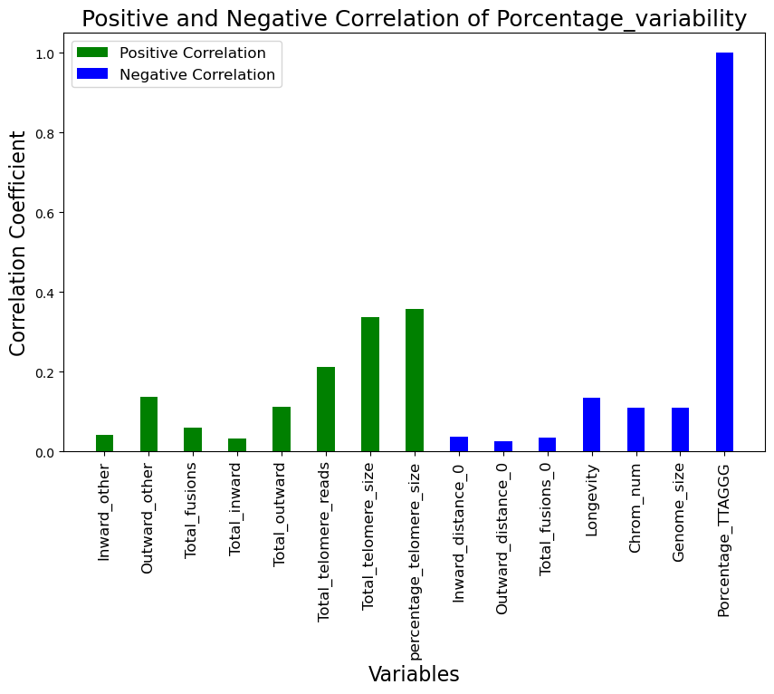
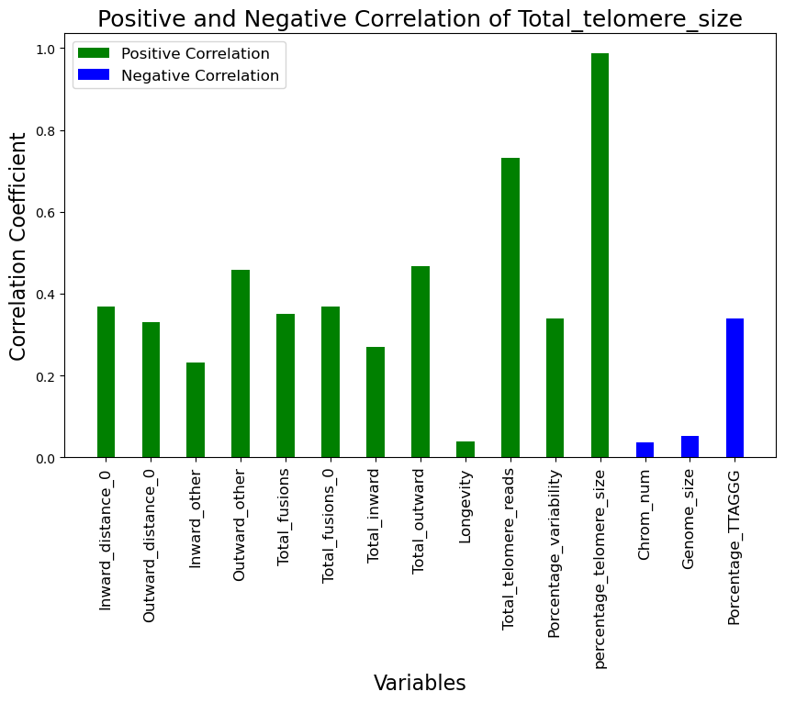

Slide 8
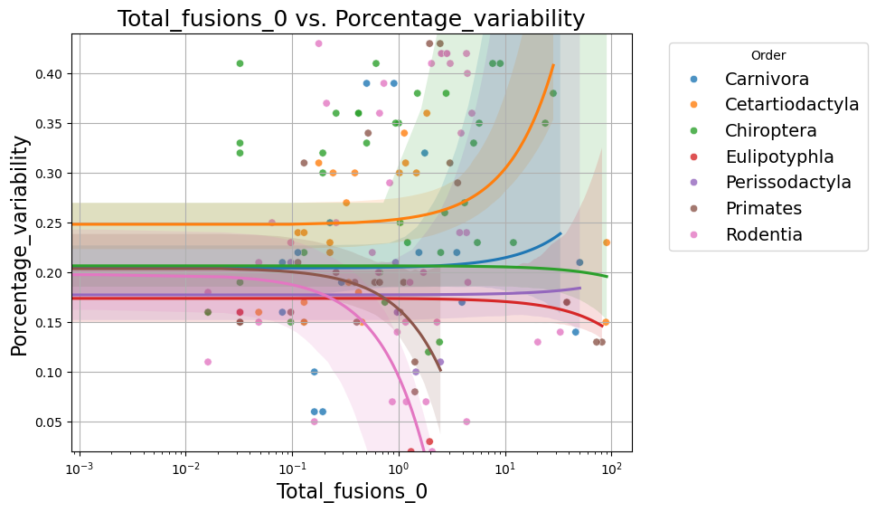
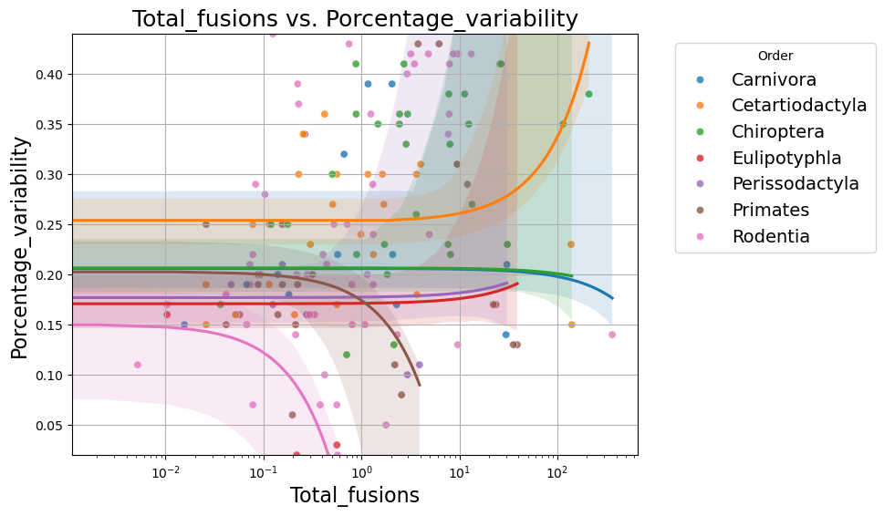
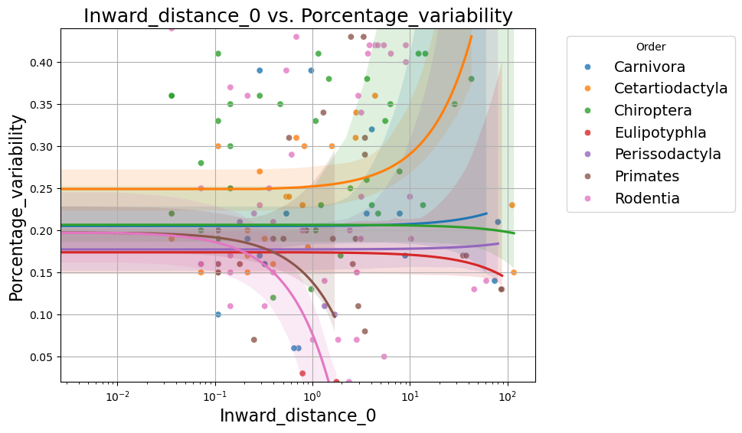
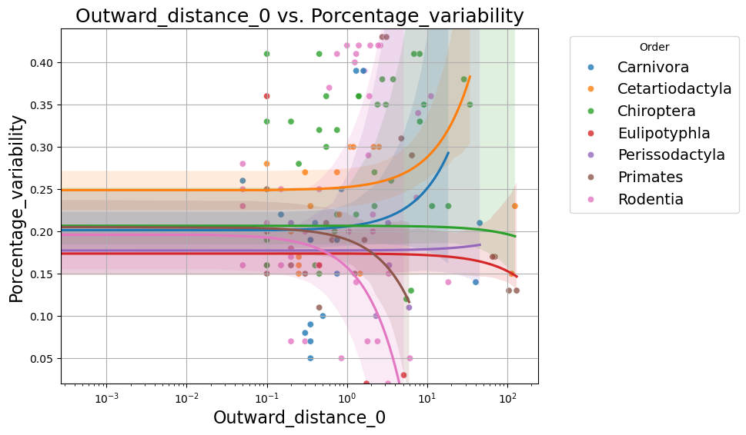

Slide 9
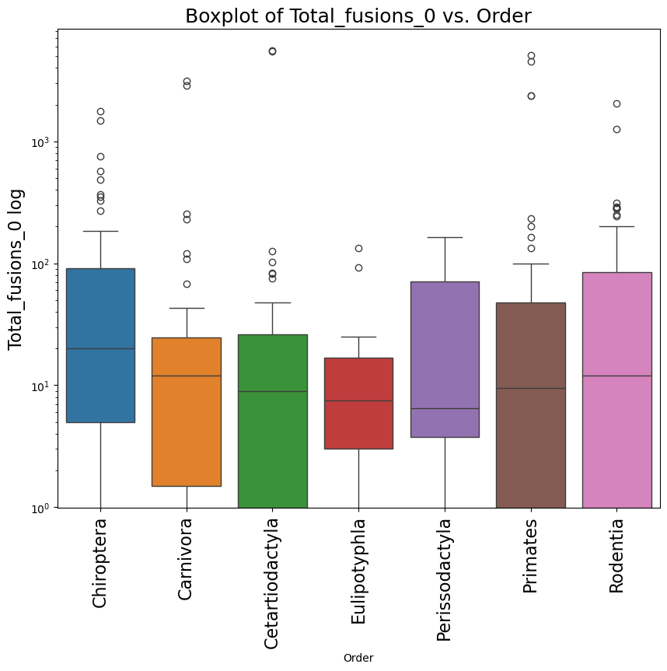
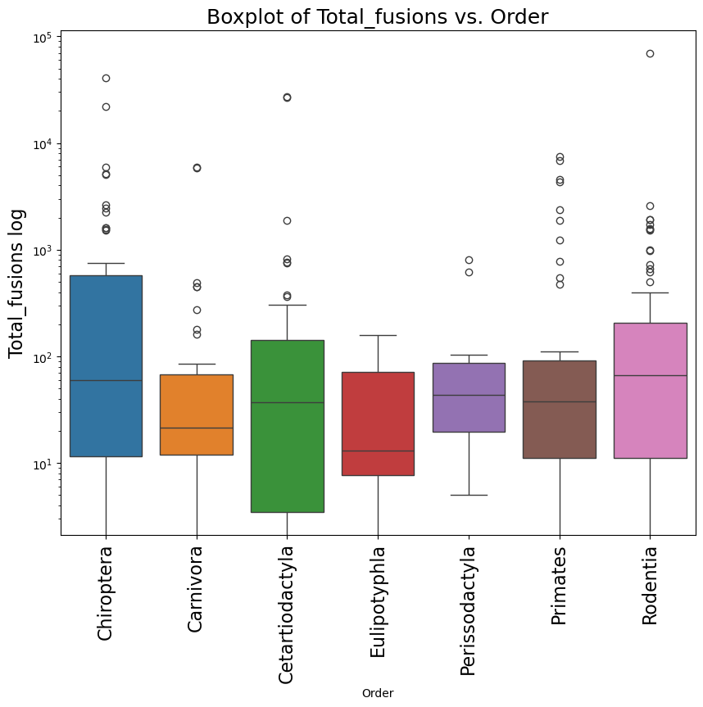
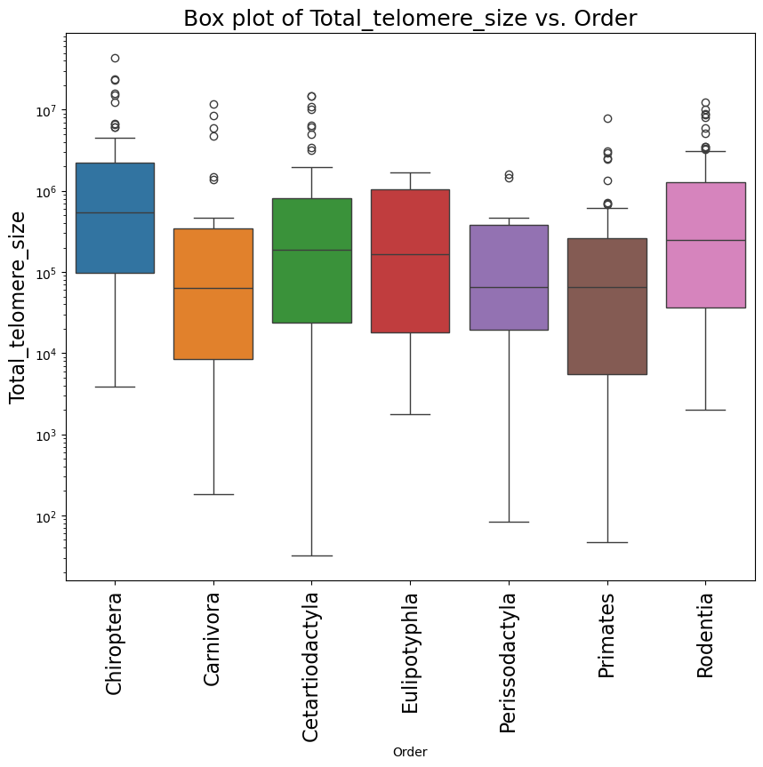
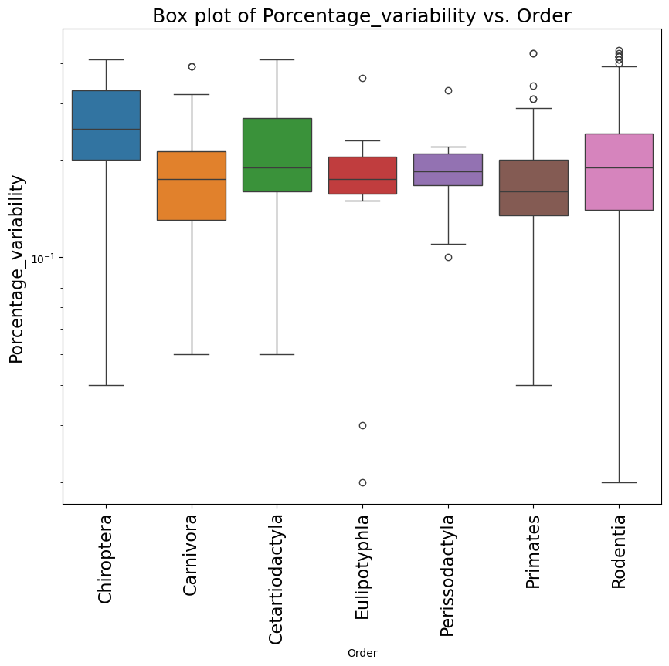
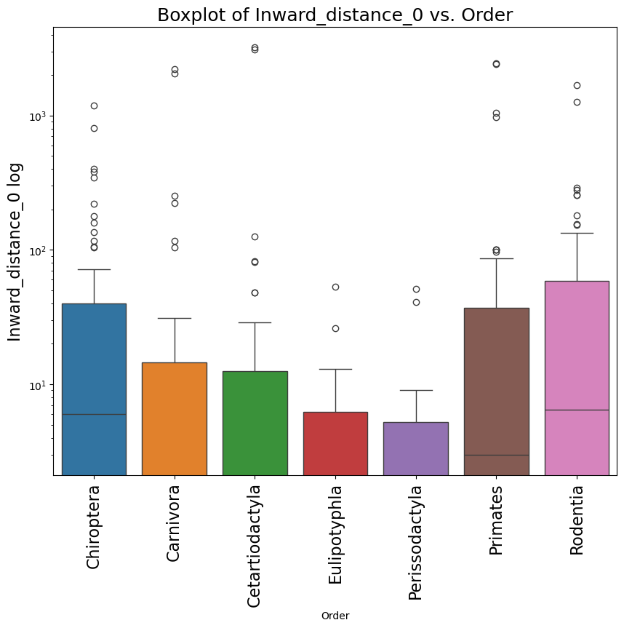
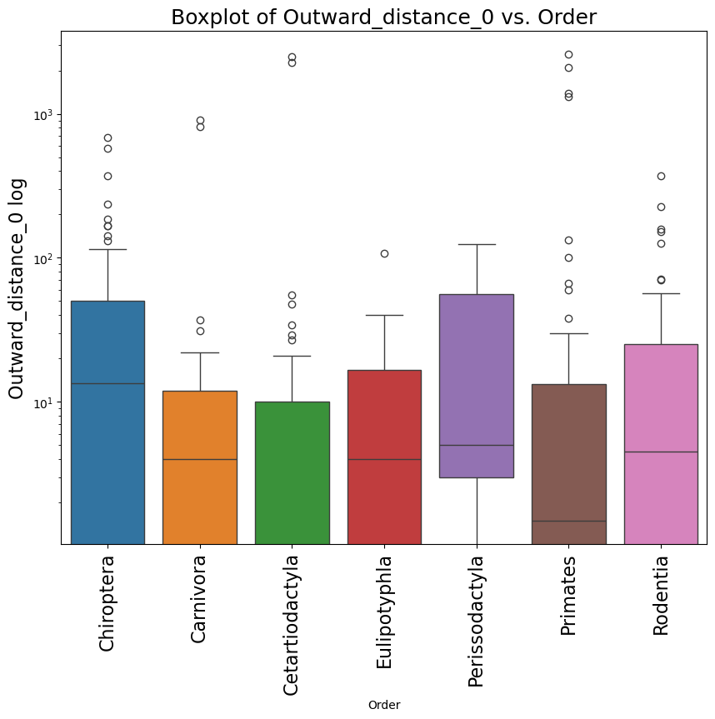

Slide 10
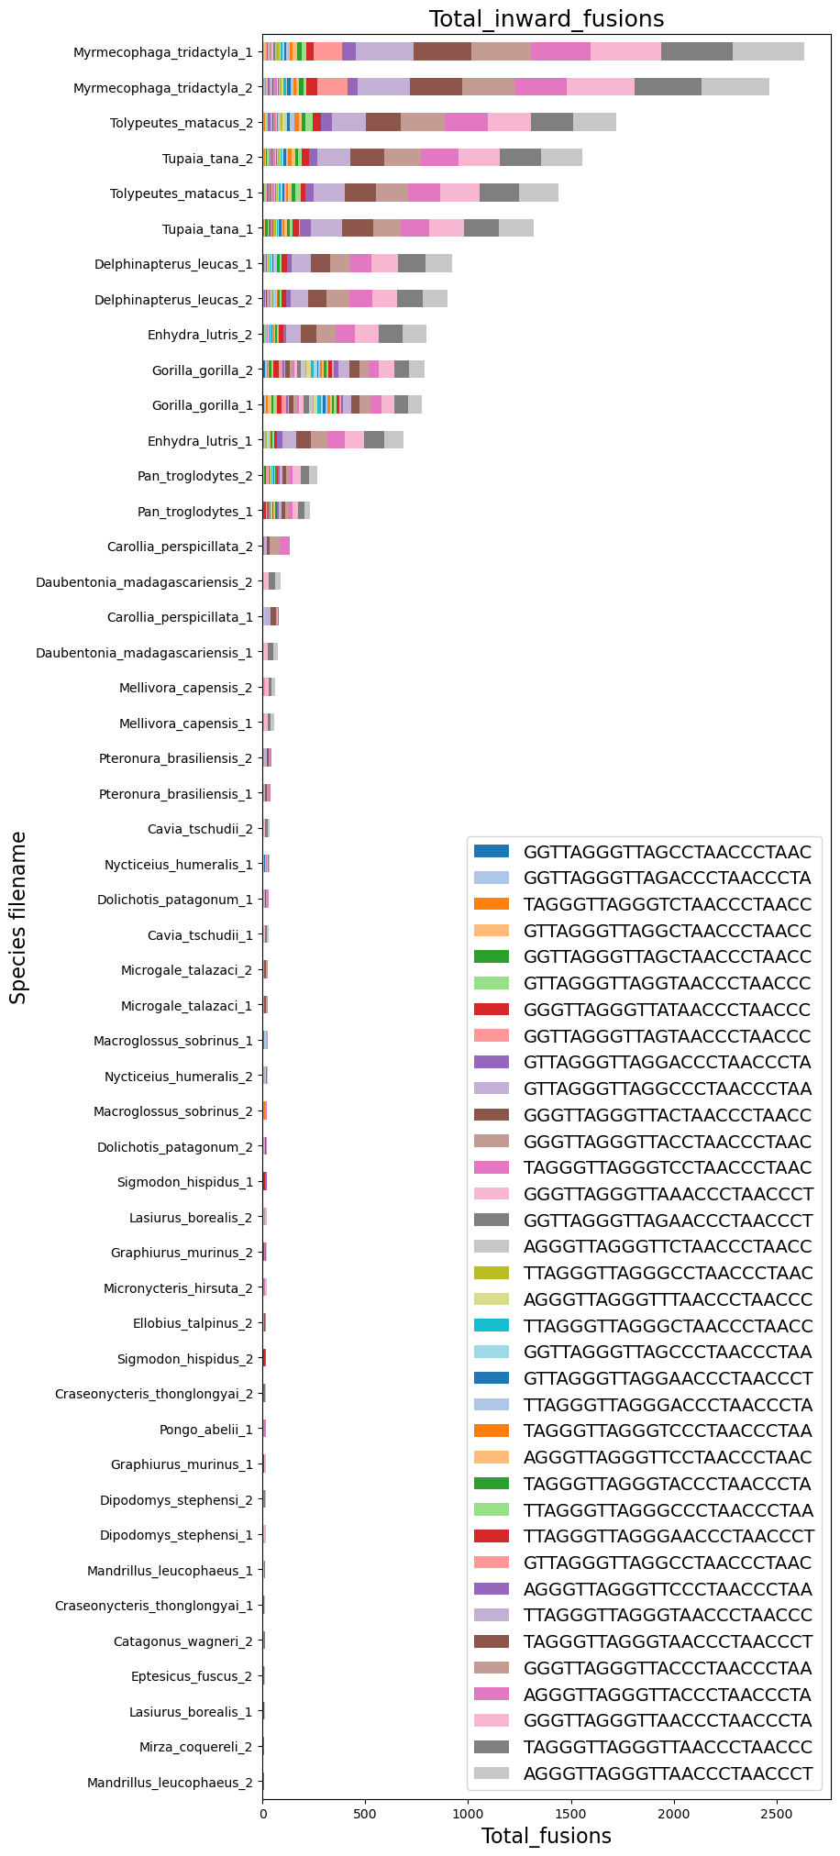
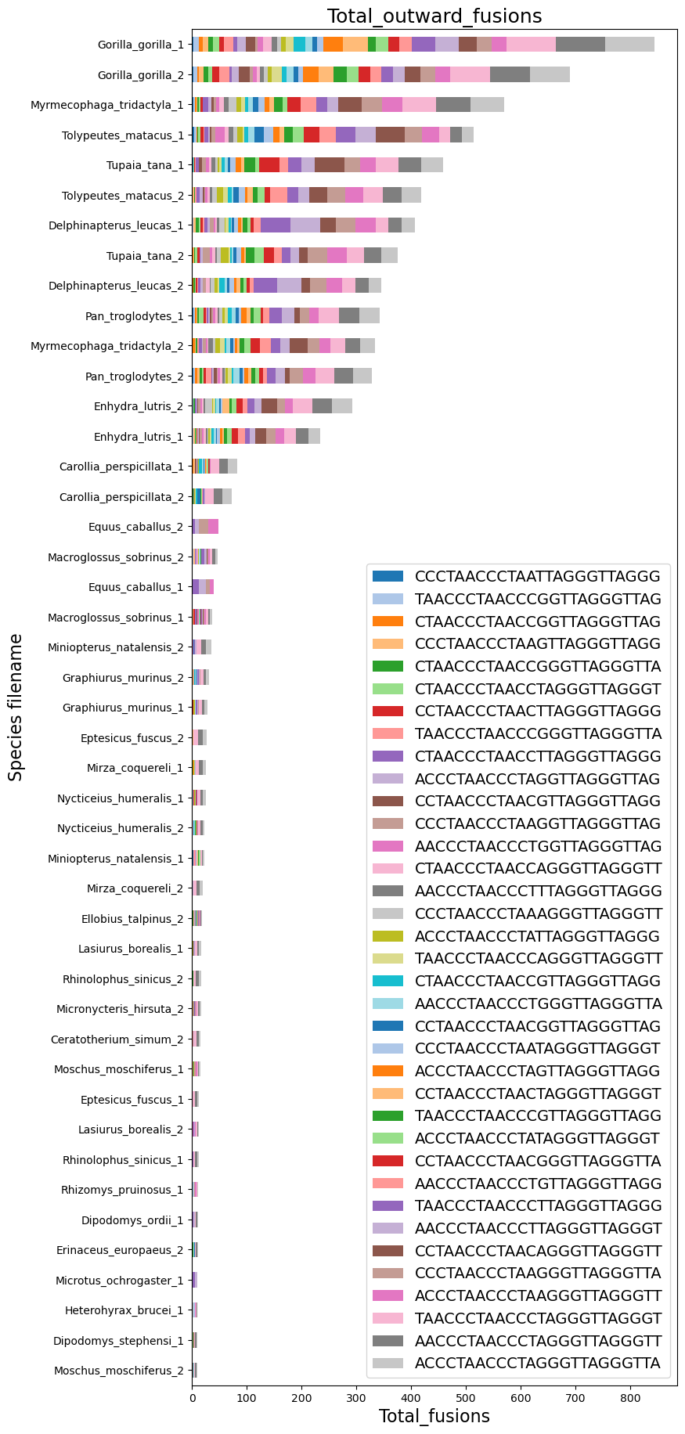
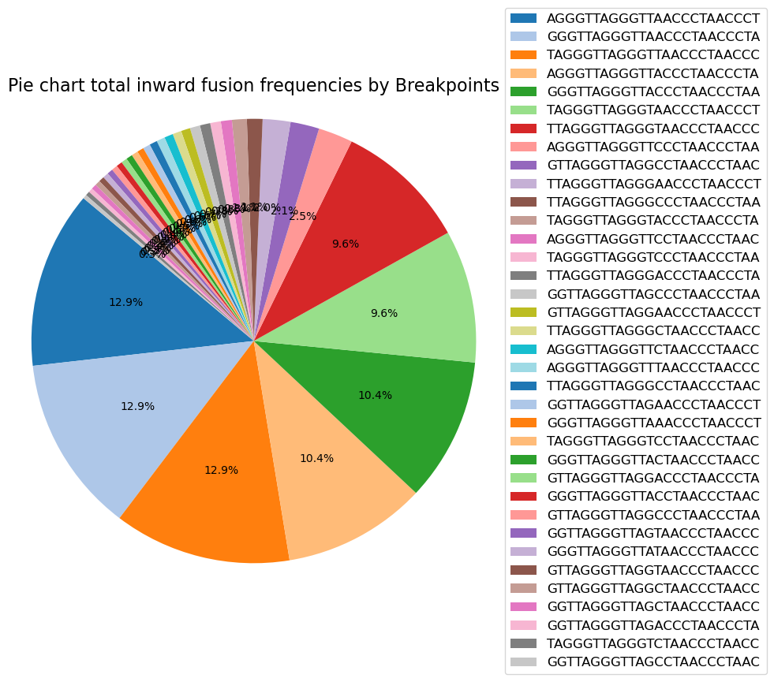

a)
b)

Slide 11



Slide 12


Slide 13


Slide 14



Slide 15




Data
Extraction
Xlsx
Cluster Parallelisation
SrrDownloader
SRA
FASTQ
FASTQ_Filterd
TelomericVariantSearcher
Filtered
fastq
TeloFusProcessor
Parallelisation
Telomeric variants
Process Pattern forward
Process Pattern reverse
BED
BED
Telomeric frecuency
Merge Coord
csv
csv
Data
Analysis
Fusion Coord
FASTA

Slide 16
Variables | Description
Inward_distance_0 | Forward + reverse with distance within the fusion equal to 0
Outward_distance_0 | Reverse + forward with distance within the fusion equal to 0
Inward_other | Forward + reverse with distance within the fusion higher than 0 and lower than 20
Outward_other | Reverse + forward with distance within the fusion higher than 0 and lower than 20
Total_fusions | Sum all fusions
Total_fusions_0 | Sum all fusions with distance 0
Total_inward | Sum all inward fusions
Total_outward | Sum all Outward fusions
Genome_coverage | The genome coverage previously calculated per run
Longevity | Lifespan of the species
Chrom_num | The number of chromosomes of each species
{protein}_g_{gene_ID} | Name of the protein selected
Total_telomere_size | Total number of selected reads, representing telomeres multiplied by the average number of base pairs in the reads
Percentage_telomere_size | Total telomere size divided by the total number of base pairs of the genome
Porcentage_variability | Total frequency of all variables divided by the total frequency of all multiplied by 100
Porcentage_TTAGGG | Total frequency of all TTAGGG divided by the total frequency of all multiplied by 100

